Slide 1
Nonlinear Planning using Constraint Posting
Lecture Module 10

Slide 2
Partial Ordering
Any planning algorithm
  that can place two actions into a plan without specifying which comes first is called a partial-order planner.
  actions dependent on each other are ordered in relation to themselves but not necessarily in relation to other independent actions.
The solution is represented as a graph of actions, not a sequence of actions.

Slide 3
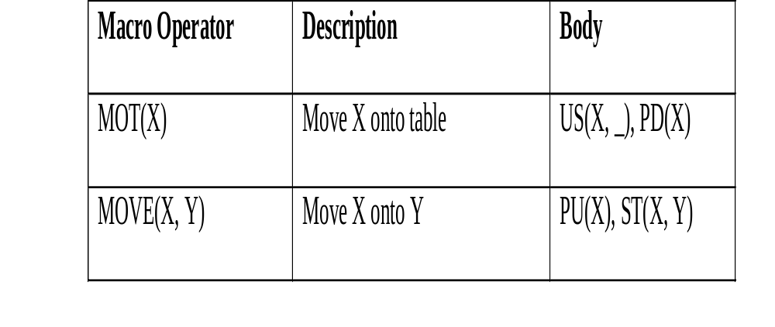
Cont..
Let us define following two macros for the sake of simplicity for block world example.

Slide 4
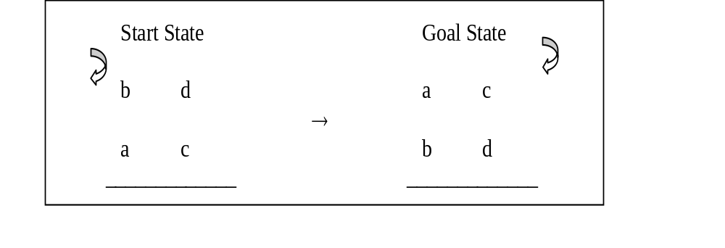
Cont…
To achieve Goal state ON(a,b),
  move ‘b’ onto table should occur before move ‘a’ to ‘b’
  Hence partial ordering MOT(b) ← MOVE(a, b) holds true
    MOT(b) should come before MOVE(a, b) in the final plan.
Similarly to achieve Goal state ON(c,d),
  partial order MOT(d) ← MOVE(c, d) is established.

Slide 5
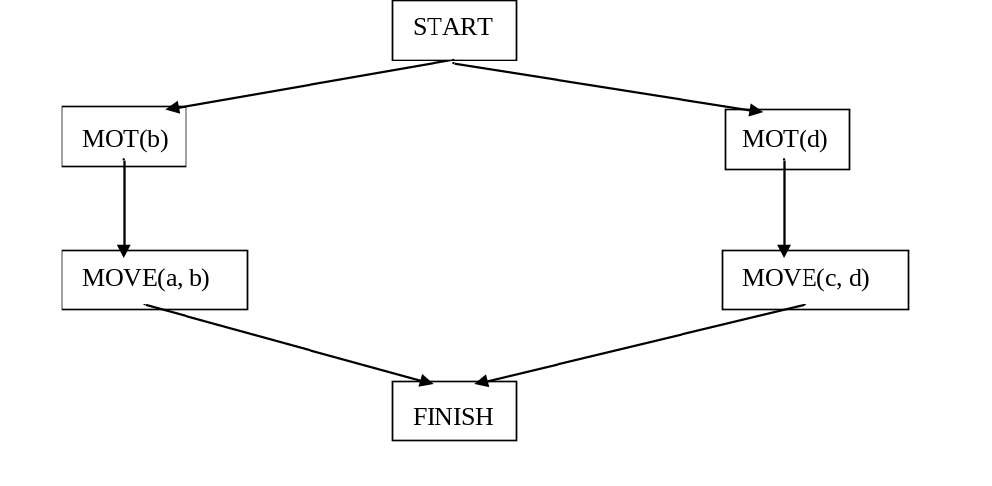
Partial Graph
Partial graph contains the dummy actions START and FINISH to mark the beginning and end of the plan in the graph.
The planner can generate total plans from the graph.

Slide 6
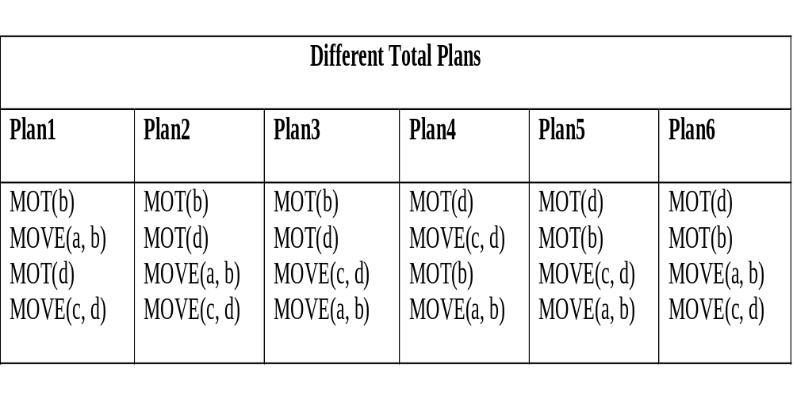
Total Plans Generation
From this representation total six plans are generated.
Each of these is called a linearization of the partial-order plan.

Slide 7
Nonlinear Planning using Constraint Posting
Idea of constraint posting is to build up a plan by incrementally
  hypothesizing operators,
  partial ordering between operators and
  binding of variables within operators
At any given time in planning process, a solution is a partially ordered, partially instantiated set of operators.
To generate actual plan, convert the partial order into any of a number of total orders.
Let us incrementally generate a nonlinear plan to solve Sussman anomaly problem.

Slide 8
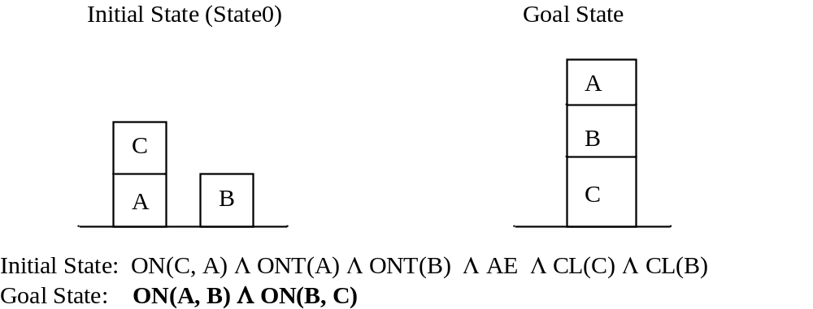
Begin with null plan (no operators).
Look at the goal state and find the operators that can achieve them.
MEA tells to choose two operators (steps) ST(A, B) and ST(B,C) with respect to post conditions as ON(A, B) and ON(B, C)

Slide 9
Pre Cond CL(B) CL(C )
*HOLD(A) *HOLD(B)
_________________________________________________
Operator ST(A, B) ST(B,C)
_________________________________________________
ON(A, B) ON(B,C)
Post Cond AE AE
~ CL(B) ~ CL(C )
~ HOLD(A) ~ HOLD(B)
______________________________________________
Here unachieved conditions are marked with * as HOLD in both the cases is not true as AE initially.
Introduce new operator (step) to achieve these goals.
This is called operator (step) addition.
Add PU operator on both the goals

Slide 10
Pre Con *CL(A) *CL(B )
ONT(A) ONT(B)
*AE *AE
Operator PU(A) PU(B)
Post Cond HOLD(A) HOLD(B)
~ ONT(A) ~ ONT(B)
~ AE ~ AE
~ CL(A) ~ CL(B )
______________________________________________________________
Pre Con CL(B) CL(C )
*HOLD(A) *HOLD(B)
Operator ST(A, B) ST(B,C)
ON(A, B) ON(B,C)
Post Cond AE AE
~ CL(B) ~ CL(C )
~ HOLD(A) ~ HOLD(B)

Slide 11
It is clear that in a final plan, PU must precede STACK operator.
Introduce the ordering as follows:
  Whenever we employ operator, we need to introduce ordering constraints called promotion.
___________________Plan 1____________________
PU(A) ← ST(A, B)
PU(B) ← ST(B, C)
________________________________________
Here we have four (partially ordered) operators and four unachieved pre conditions:- CL(A), CL(B ), AE on both the paths
  CL(A) is unachieved as top of A is not clear in initial state.
  Also CL(B) is unachieved even though top of B is clear in initial state but there exist a operator ST(A,B) with post condition as ~CL(B).
  Initial State: ON(C, A)Λ ONT(A) Λ ONT(B) Λ AE Λ CL(C) Λ CL(B)

Slide 12
If we make sure that PU(B) precede ST(A, B) then CL(B) is achieved. So post the following constraints.
________________Plan 2__________________________
PU(B) ← ST(A, B)
___________________________________________
Note that pre condition CL(A) of PU(A) still is unachieved.
Let us achieve AE preconditions of each Pick up operators before CL(A).
Initial state has AE. So one PU can achieve its pre condition but other PU operator could be prevented from being executed.
Assume AE is achieved as pre condition of PU(B) as its other preconditions have been achieved. So put constraint.
Promotion:
___________________Plan 3___________________________
PU(B) ← PU(A) (pre conds of PU(A) are not still achieved.)
_____________________________________________

Slide 13
Now all preconditions of PU(B) are achieved.
Here apply another heuristic called declobbering.
Decobbering:
  Placing operator Op2 between two operators Op1 and Op3 such that Op2 reasserts some pre conditions of Op3 that was negated by Op1.
Since PU(B) makes ~AE and ST(B,C) will make AE which is precondition of PU(A), we can put the following constraint.
_________________Plan 4________________________
PU(B) ← ST(B, C) ← PU(A)
____________________________________________
  Here PU(B) is said to clobber pre condition of PU(A) and ST(B, C) is said to declobber it. (removing deadlock)

Slide 14
Now try to achieve CL(A). This can be done by US(C, A)
Pre Con ON(C, A)
* CL(C)
*AE
Operator US(C, A)
Post Cond ~ AE
CL(A)
HOLD(C)
~ ON(C, A)
_____________________________________________________________
Pre Con *CL(A) CL(B )
ONT(A) ONT(B)
AE AE
Operator PU(A) PU(B)
Post Cond HOLD(A) HOLD(B)
~ ONT(A) ~ ONT(B)
~ AE ~ AE
~ CL(A) ~ CL(B )
______________________________________________________________

Slide 15
Initial State: ON(C, A) Λ ONT(A) Λ ONT(B) Λ AE Λ CL(C) Λ CL(B)
ON(C, A) can easily be seen to be true in initial state.
Even though *CL(C) is also true in initial state but may be denied by operator ST(B,C) already used earlier.
Similarly *AE may be denied by operators PU(A) and PU(B). So put constraints
Promotion:
_________________Plan 5__________________________
US(C, A) ← ST(B, C)
US(C, A) ← PU(A)
US(C, A) ← PU(B)
____________________________________________
Now adding new operator requires checking, if the new step clobber some pre conditions of later.

Slide 16
We notice that PU(B) requires AE but denied by new operator US(C,A).
One way is to add a new declobbering operator that makes AE to the plan . This can be done by PD(C).
Pre Con HOLD(C)
Operator PD(C)
Post Cond ~HOLD(C)
ONT(C) AE
~ CL(A)
Declobbering:
_______________Plan 6____________________
US(C, A) ← PD(C) ← PU(B)
_____________________________________

Slide 17
Combine the following partial plans to generate final plan. Possible operators used are: PU(A), PU(B), ST(A,B), ST(B,C), US(C,A), PD(C)
____________________________________________
PU(A) ← ST(A, B)
PU(B) ← ST(B, C)
____________________________________________
PU(B) ← ST(A, B)
____________________________________________
PU(B) ← PU(A)
(pre conds of PU(A) are not still achieved.)
_____________________________________________
PU(B) ← ST(B, C) ← PU(A)
_____________________________________________
US(C, A) ← ST(B, C)
US(C, A) ← PU(A)
US(C, A) ← PU(B)
____________________________________________
US(C, A) ← PD(C) ← PU(B)
____________________________________________
Final plan:
US(C, A) ← PD(C) ← PU(B) ← ST(B, C) ← PU(A) ← ST(A, B)

Slide 18
Main steps involved in non linear plan generation are:
Step addition -
Creating new operator (step) for a plan
2. Promotion -
Constraining one operator to come before another in final plan
3. Declobbering -
Placing operator Op2 between two operators Op1 and Op3 such that Op2 reasserts some pre conditions of Op3 that was negated by Op1
4. Simple Establishment-
Assigning a value to a variable, in order to ensure the pre conditions of some step.

Slide 19
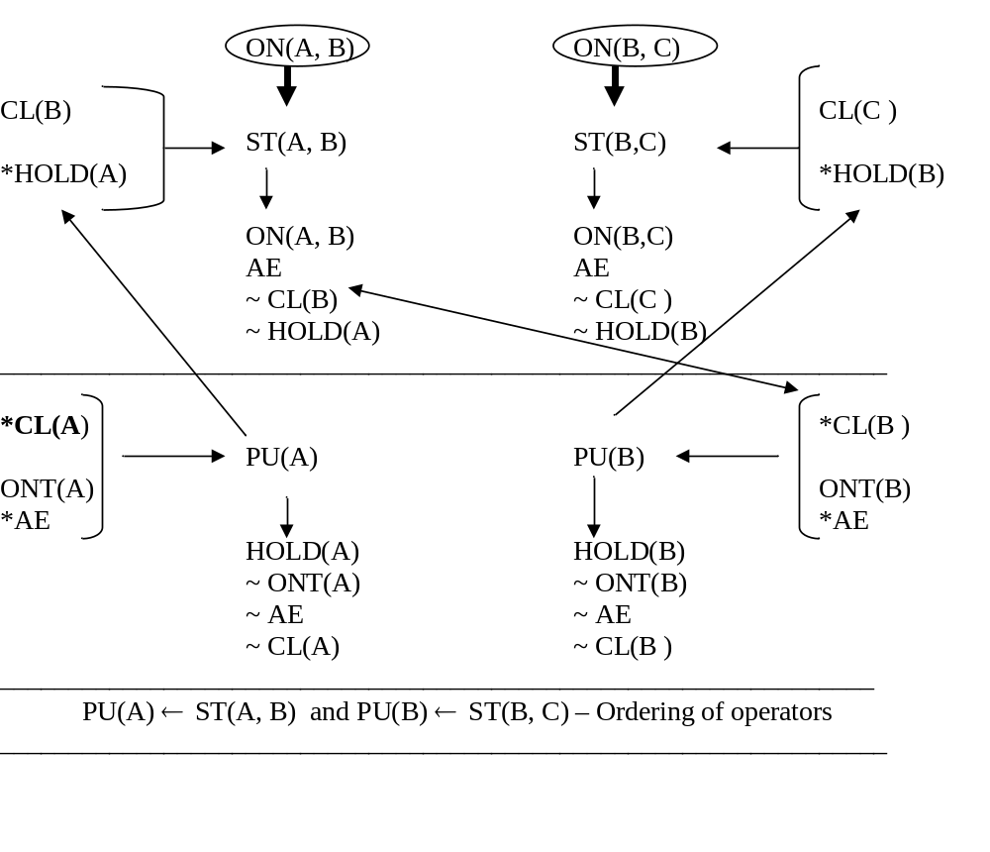
Summary
Initial State: ON(C, A) Λ ONT(A) Λ ONT(B) Λ AE Λ CL(C) Λ CL(B)
Goal State: ON(A, B) Λ ON(B, C)

Slide 20
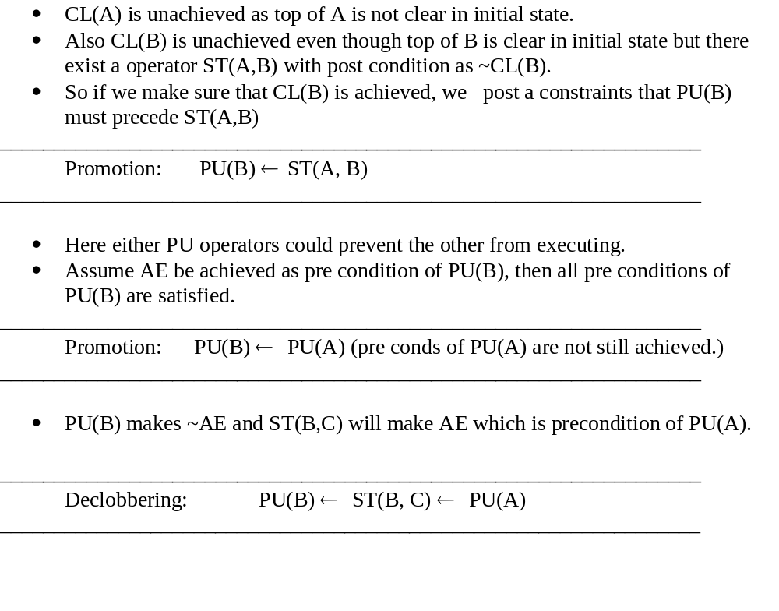

Slide 21
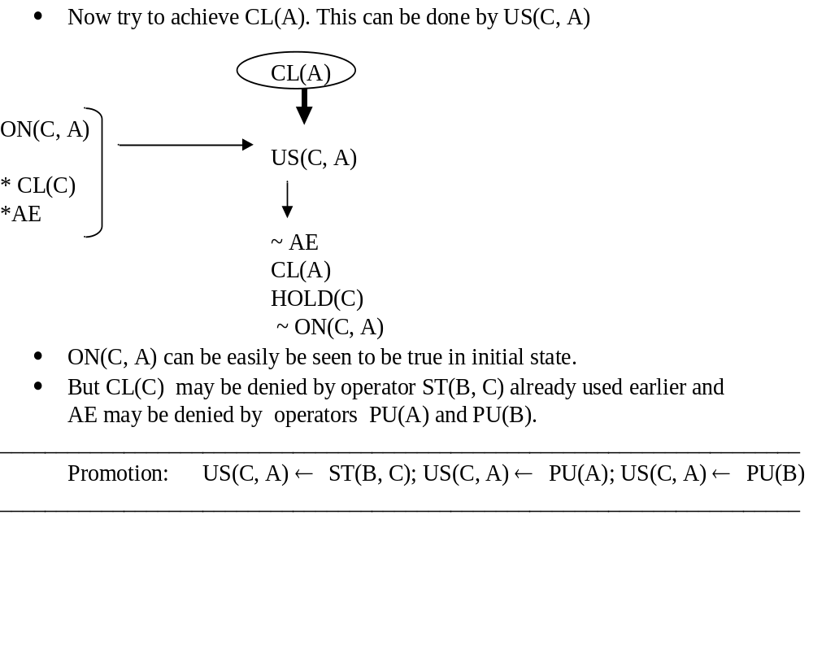

Slide 22
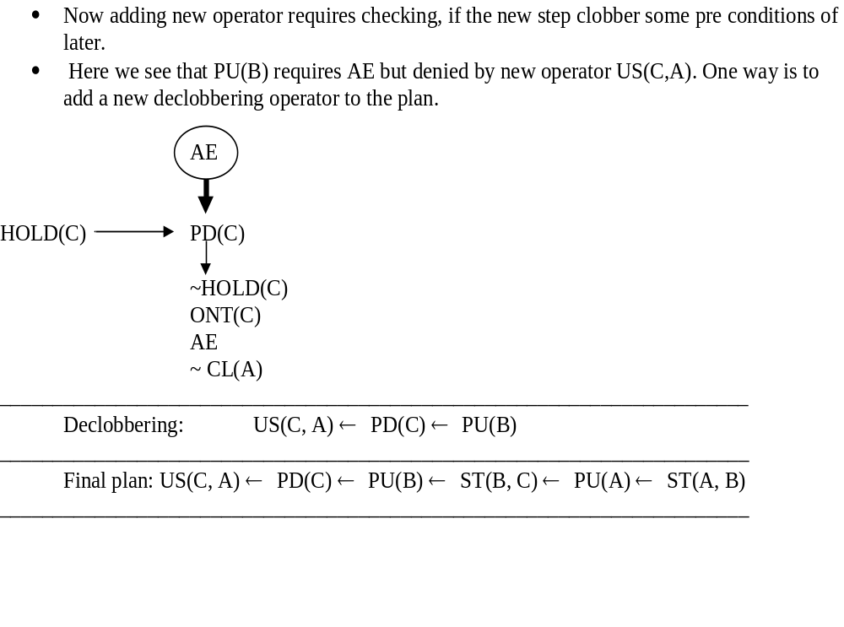

Slide 23
Algorithm:
Initialize S to be set of propositions in the goal state.
Remove some unachieved proposition P from S.
Achieve P by using step addition, promotion, declobbering, simple establishment.
Review all the steps in the plan, including any new steps introduced by step addition to see if any of their preconditions are unachieved.
Add to S the new set of unachieved preconditions.
If S = φ, complete the plan by converting the partial order of steps into a total order and instantiate any variables as necessary and exit.
Otherwise go to step 2.

Slide 24
Learning Plans
In many problems plans may share a large number of common sequence of actions.
So planner requires the ability to recall and modify or reuse the existing plans.
Macro operators can be defined as sequence of operators for performing some task and saved for future use.
For Ex: Reverse_blocks(X, Y) can be macro operator with plan – US(X, Y), PD(X), PU(Y), ST(Y, X), where X, Y are variables.
The generalized plan schema is called MACROP and is stored in a data structure called Triangle table.
It helps planner to build new plans efficiently by using existing plans.

Slide 25
Triangle Table
It provides a way of removing the goals that each operator is expected to satisfy as well as goals that must be true for it to execute correctly.
A useful graphical mechanism to show the plan evolution as well as link the succession of operators in a triangle table.
The structure of the table is staircase type which gives compact summary of the plan.
Let us use the following acronyms.
AL(Op) - add-list of op
ACC - above cell contents
DL(Op) - del-list of op

Slide 26
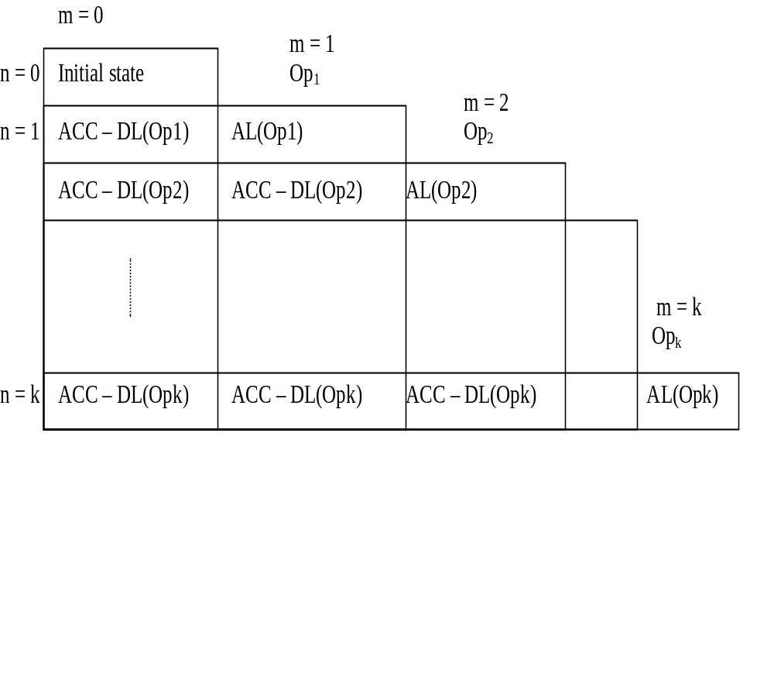

Slide 27
Rules for forming such tables
Given a resulting plan requiring the successive use of k operators, Op₁, Op₂, …Op_{k}, the table consists of
  k+1 columns indexed by m from left to right with values 0 to k.
  Similarly k+1 rows indexed by n from top to bottom with values 0 to k.
Each cell may be empty or composed of a subset of the system state.
Cell(0,0) contains initial state.
Entries in the cells are made as follows:
  In Cell(m, m), for m > 0, Add add-list of operator.

Slide 28
      For each cell of column m, n > m, the Cell(m, n) contains the contents of Cell(m, n-1) with del-list of operator Operator m removed.
This process starts with Cell(0, 0).
Traversing the columns from top to bottom have reduction in the system state entries due to the succession of operator del-list applications.
Finally when the table is complete, the union of the facts in the bottom row (n = k) represents the goal state.
Let us consider macro-operator “reverse” with the sequence of operators as:
US(X,Y), PD(X), PU(Y), S(Y,X)
  Here X and Y are variables and can be bound with actual objects.

Slide 29
